Slide 1
E-news Express
Statistical Analysis
of Business Data
By Atchara Chantharak

Slide 2
Contents
Business Problem Overview and Solution Approach
Data Overview
Key Findings and Insights
Conclusions

Slide 3
Business Problem Overview and Solution Approach
E-news Express plans to expand its business by acquiring new subscribers. Understanding consumer interests and wants will help determine whether a new feature will be effective or not.
The approach is to run an experiment called an a/b testing by:
Created the new landing page and ran it along with the old landing page.
Randomly selected 100 users and divided them equally into two groups.
Analyzed the results to decide whether the new landing page is more effective to gather new subscribers.
Used 95% confidence interval for all analysis.

Slide 4
Data Review
100 randomly selected user ids
50 users in the Control group: the old landing page
50 users in the Treatment group: the new landing page
Choice of Language
English
Spanish
French
Collected time visitors spent on the landing page
Converted status: yes and no

Slide 5
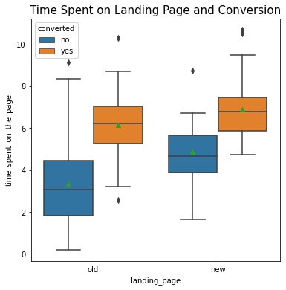
Key Findings and Insights
Average time spent on landing page
The new landing page is 6.22 minutes
The old landing page is 4.53 minutes.
95% confidence interval, the users spend more time on the new landing page than the old landing page

Slide 6
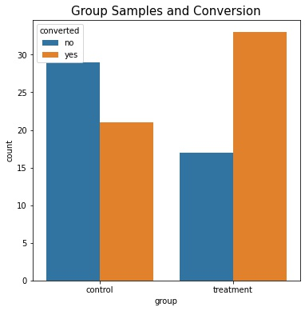
Key Findings and Insights (cont’d)
Conversion Rate
Control group: 58% ( 29 yes and 21 no)
Treatment Group: 66% ( 33 yes and 17 no)
95% confidence interval, the conversion rate for the new landing page is greater than the conversion rate for the old landing page.
For both sample groups, there is correlation between time the users spent on the landing page and the conversion. The longer a user spent time on the page, the higher chance for them to subscribe.

Slide 7
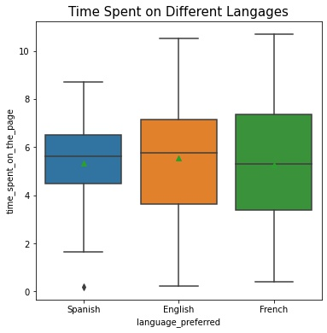
Key Findings and Insights (cont’d)
Time Spent and Language
Average Time Spent from most to least
English- 5:34 minutes
French- 5:20 minutes
Spanish- 5:15 minutes
On average, users spent similar amount of time on the landing page. However, French has the largest spread of time spent and Spanish has the least spread.

Slide 8
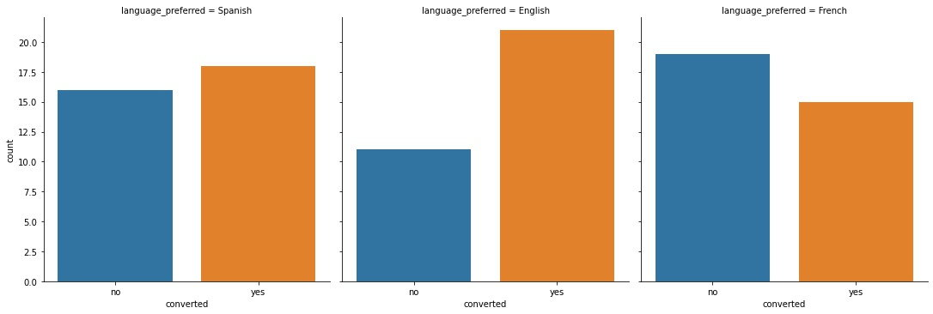
Key Findings and Insights (cont’d)
Language and Converted Status
Spanish- 34 users: 18 converted, English- 32 users: 21 converted, and French- 34 users: 15 converted.
English has the highest converted counts, closely follow by Spanish, and French.
95% confidence interval, we do not have enough statistical significance to conclude that the converted status depend on preferred language.

Slide 9
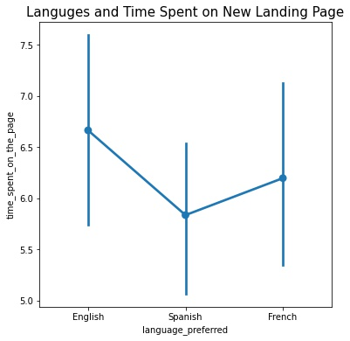
Key Findings and Insights (cont’d)
Language & Time Spent on New Landing Page
On Average time spent from most to least
English: 6.40 minutes
French: 6.12 minutes
Spanish 5.50 minutes
95% confidence interval, we do not have enough statistical significance to conclude that language has effect on time users spent on the new landing page.

Slide 10
Conclusions
With 95% Confidence Interval:
On average, users spent more time on the new landing page.
Users who became subscribers spent more time on a landing page.
The conversion rate of the new landing page is greater than that of the old landing page.
We do not have enough statistic evidence to conclude that the converted status and time users spent on the landing page depend on language.
From this experiment, the conclusion is that the new landing page, a new feature, is more effective to gather new subscribers.

